Slide 1
✈️ SkyFare Predictor
Airline Ticket Price Prediction
using Machine Learning
By Pratham Sonpal
Github: https://github.com/PrathamSonpal/SkyFare-Predictor
Streamlit: https://skyfare-predictor.app

Slide 2
1. Project Overview
SkyFare Predictor: An intelligent ML web application.
Goal: Solve the volatility of airline ticket pricing.
Input: User provides Airline, Source, Stops, etc.
Output: Instant fare estimation (₹) using Random Forest.
Status: Deployed Live on Streamlit Cloud.

Slide 3
2. Data & Features
Dataset: Cleaned flight data (CSV).
Feature Engineering Pipeline:
• 'Duration': Converted 2h 30m ➝ 150 mins.
• 'Days Left': Key indicator for dynamic pricing.
• 'Dep/Arr Time': Split into Hour/Minute columns.
• Encoding: One-Hot for Cities, Label for Stops.

Slide 4
3. Key Data Insights
Price vs. Days Left: Strong inverse relationship. Tickets booked 1–2 days before departure are 30-40% higher than those booked 15+ days in advance.
Airline Variation: Premium airlines (e.g., Vistara Business) show significantly higher median variance compared to budget carriers (e.g., AirAsia, Indigo).
Duration Impact: Contrary to intuition, flights with 1 stop are often cheaper than non-stop flights on long routes due to lower convenience demand.
Time of Day: Early morning departures (6 AM – 9 AM) command a premium due to high business travel demand.

Slide 5
4. Machine Learning Model
Algorithm: Random Forest Regressor
Why Random Forest?
• Captures non-linear price jumps.
• Handles complex interactions (e.g., Airline + Stops).
Configuration:
• Estimators: 50
• Max Depth: 12
• Accuracy (R²): 92.14%

Slide 6
5. Performance Metrics
R² Score | MAE (Error) | RMSE
92.14% | ₹3414.72 | 6366.13

Slide 7
6. Challenges & Future Scope
Challenges Faced:
  Data Cleaning: Handling inconsistent duration formats (e.g., "1h 5m" vs "15m") was complex and required custom parsing logic.
  Outliers: Extreme price outliers in Business Class skewed early model training; handled via Robust Scaling.
Future Scope:
  Live Data Integration: Moving from a static CSV to a real-time Flight API for up-to-the-minute predictions.
  Deep Learning: Experimenting with Neural Networks (e.g., LSTMs) to capture sequential time-series patterns.
  Route Expansion: Scaling the model to include international routes and multi-city layovers.

Slide 8
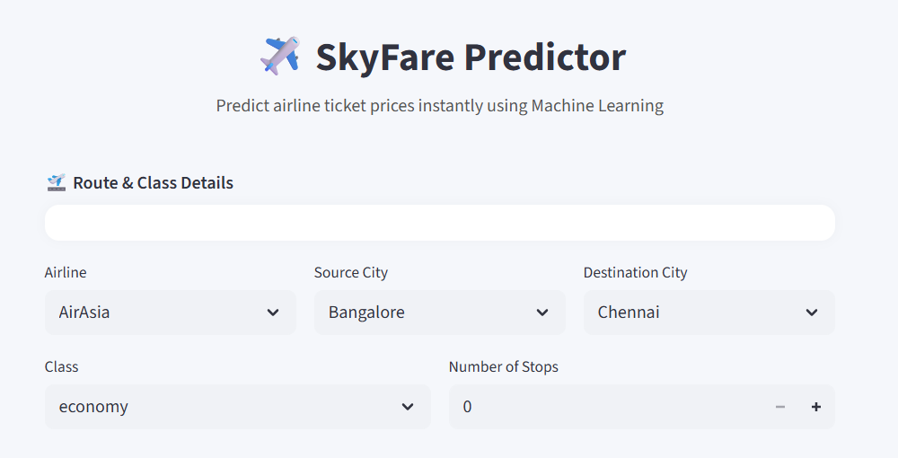
7. Application Interface
Live App Link: https://skyfare-predictor.streamlit.app

Slide 9
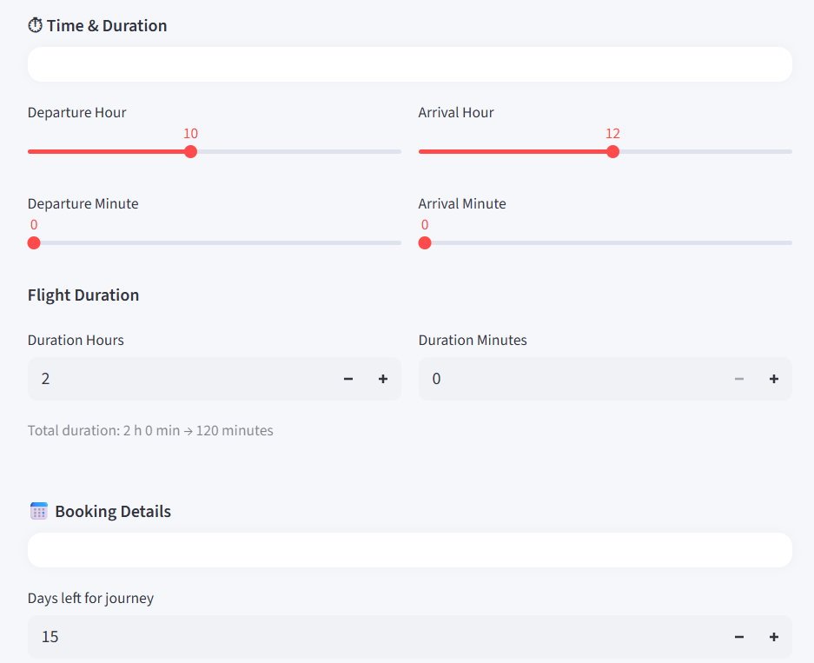

Slide 10
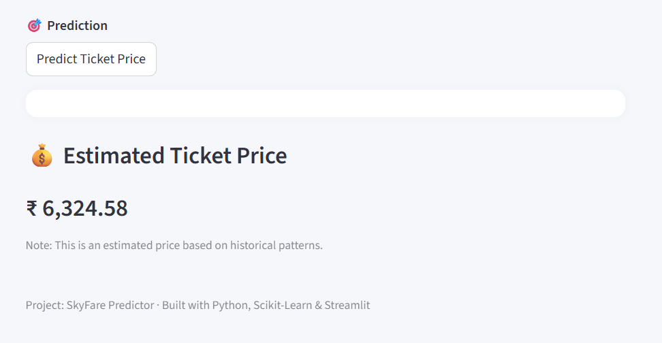

Slide 11
8. Conclusion
Summary: Successfully built an end-to-end pricing engine.
Impact: Helps users find the best time to fly.
Deliverables:
• Source Code (GitHub)
• Research Report (PDF)
• Live Web App
Github: https://github.com/PrathamSonpal/SkyFare-Predictor
Streamlit: https://skyfare-predictor.app

Slide 12
Thank You

